Slide 1
Lightweight Cryptographic to the FPGA
Advance SOC Final Project
F11921061 郭霖璟 / R12921A10 謝宗翰 / R12921068 吳凱濠

Slide 2
Background Introduction
Increasing Demand
With the development of the Internet of Things (IoT), the demand for security on embedded devices is getting higher and higher.
ASCON
ASCON is a lightweight hash function and AEAD (authenticated encryption with associated data) family. It has recently been selected as the primary choice in the LWC project by NIST.
Lightweight Crypto Challenges
As the main aim of lightweight cryptography are resource-constrained embedded devices, one of the main concerns are efficient implementations and protection against physical attacks.
Notes:
challenge -> 物理上的攻擊

Slide 3
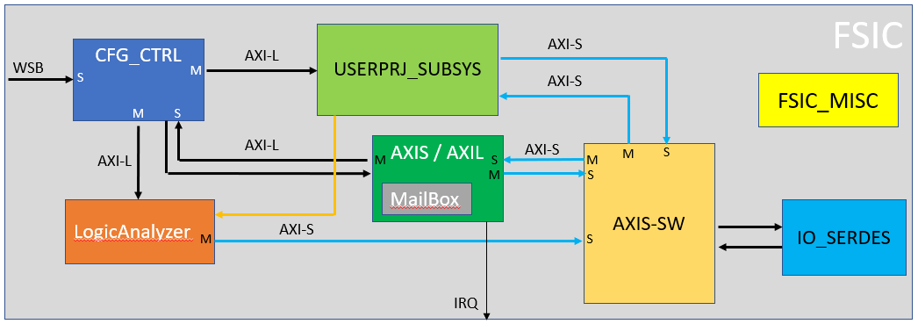
FSIC
Put ASCON.v into user project0

Slide 4
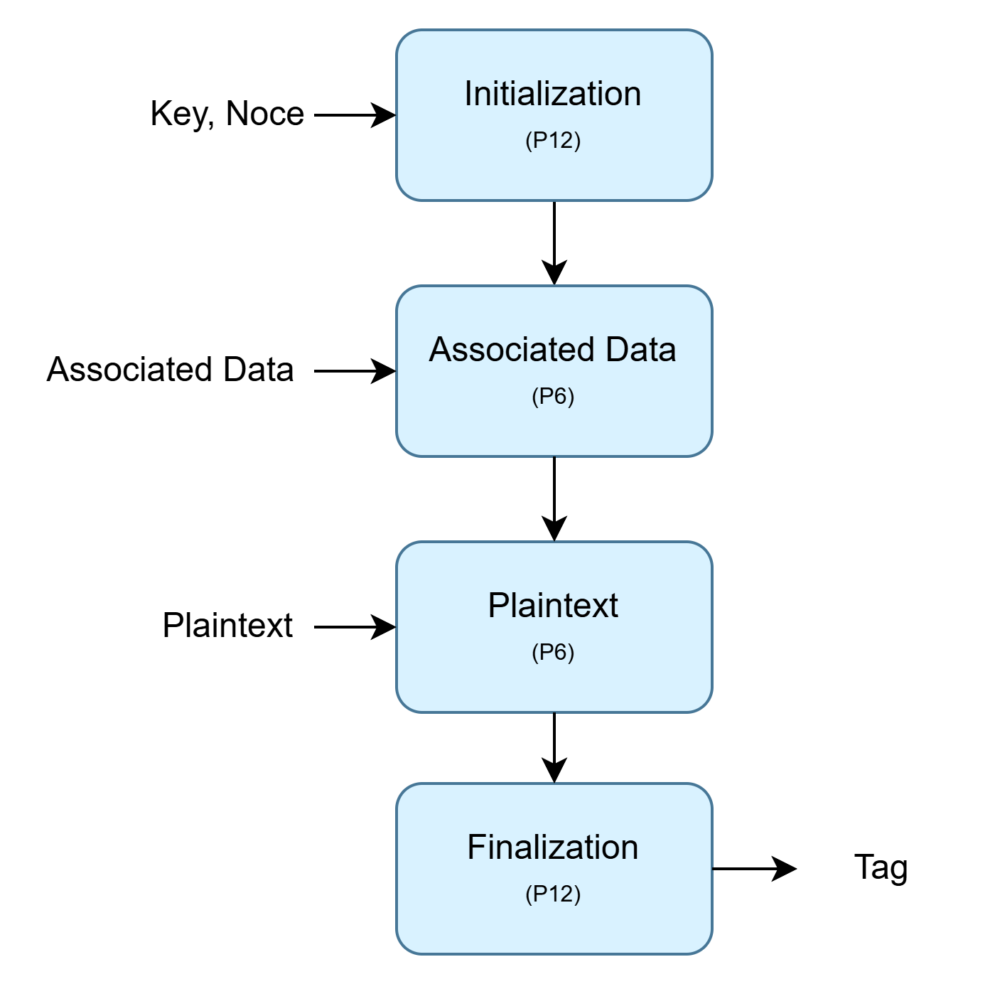
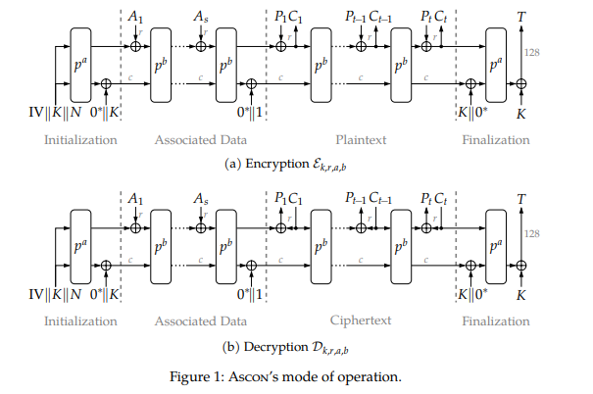

IP Structure Design
(Paper)

Slide 5
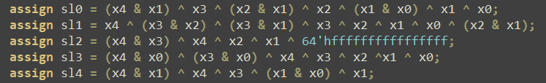
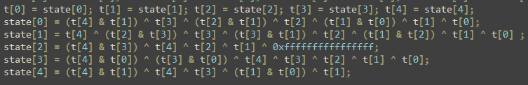
把C弄成HLS的考量
Verilog
C/HLS-C

Slide 6
How to use our IP
Port Name | Port Address | Width (bit) | Port Functionality
reg_rst | 0x00 | 1 | reset IP when rest_rst = 1
reg_key1 - 4 | 0x04 - 0x10 | 32 | 128 bit key for encrypt plaintext
reg_nonce1 - 4 | 0x14 - 0x20 | 32 | input with key
adlen | 0x24 | 32 | associate data length
plen | 0x28 | 32 | number of plaintext

Slide 7
Challenges when designing ASCON IP
Different input width between FSIC and IP
The original design of the HLS IP input port was 128 bits, but FSIC data input port is only 32 bits, therefore the input have to divide into 4 x 32bits.
Cosim hang out when RTL simulation
Due to the aforementioned issue (different width). The numbers of adlen and plen were incorrect, leading to a cosim hang out.
key, nonce
128bits
32bit | 32bit | 32bit | 32bit

Slide 8

Put our HLS result into FSIC
Cannot transfer data through testbench
When integrated into FSIC, we are unable to transmit data. Ultimately, it was discovered that when reg_rst set to 1, IP does not receive input or generate output.
Only after all key, nonce, adlen, plen are programmed, and reg_rst is then set to 0, IP begin to receive input and produce output.
reg_rst = 0

Slide 9

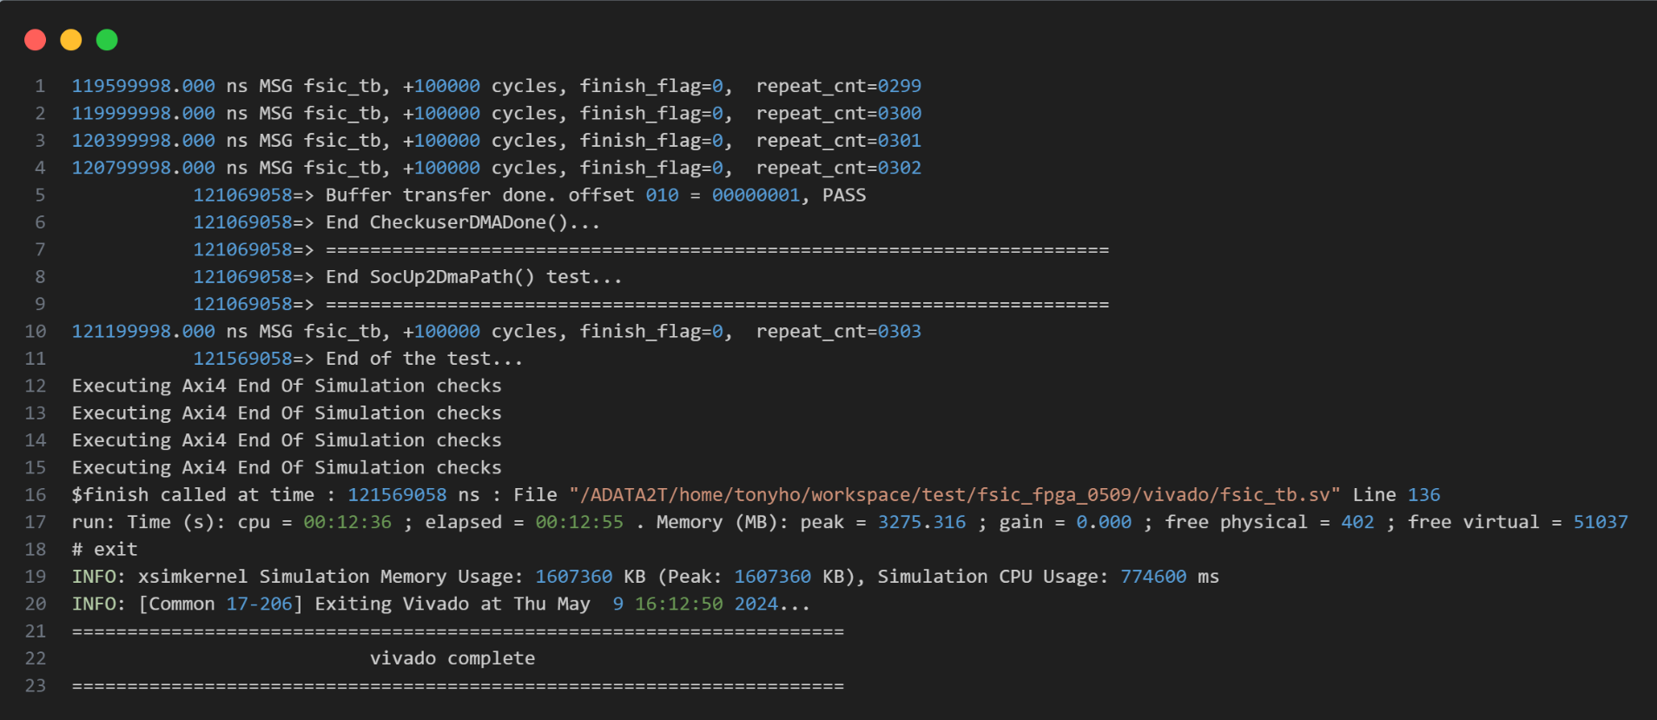
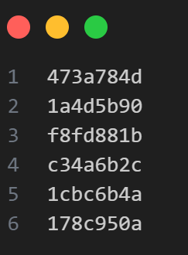
Simulation Result
Simulation Result
We can successfully pass the simulation without error

Slide 10
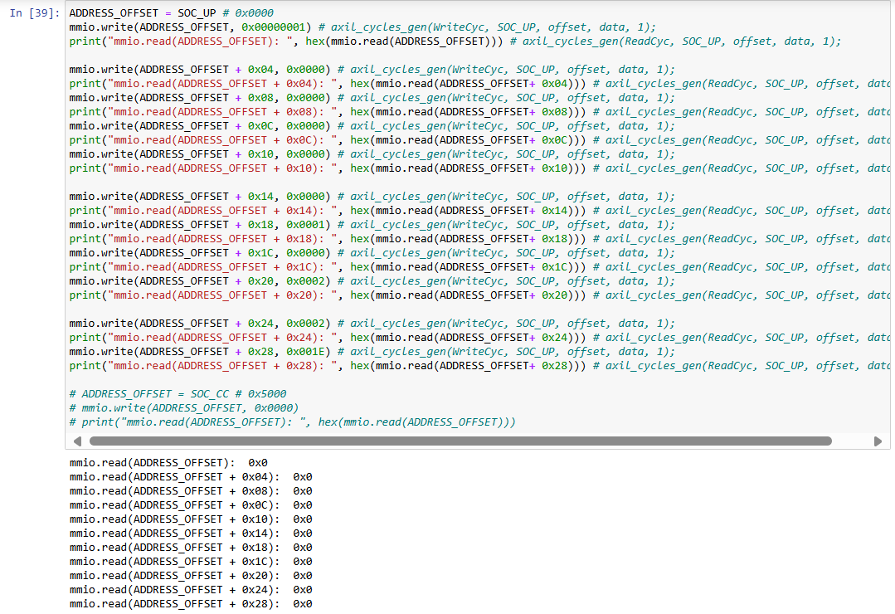

User project R/W test
Can not read the
user project data (SOC_UP) !!

Slide 11
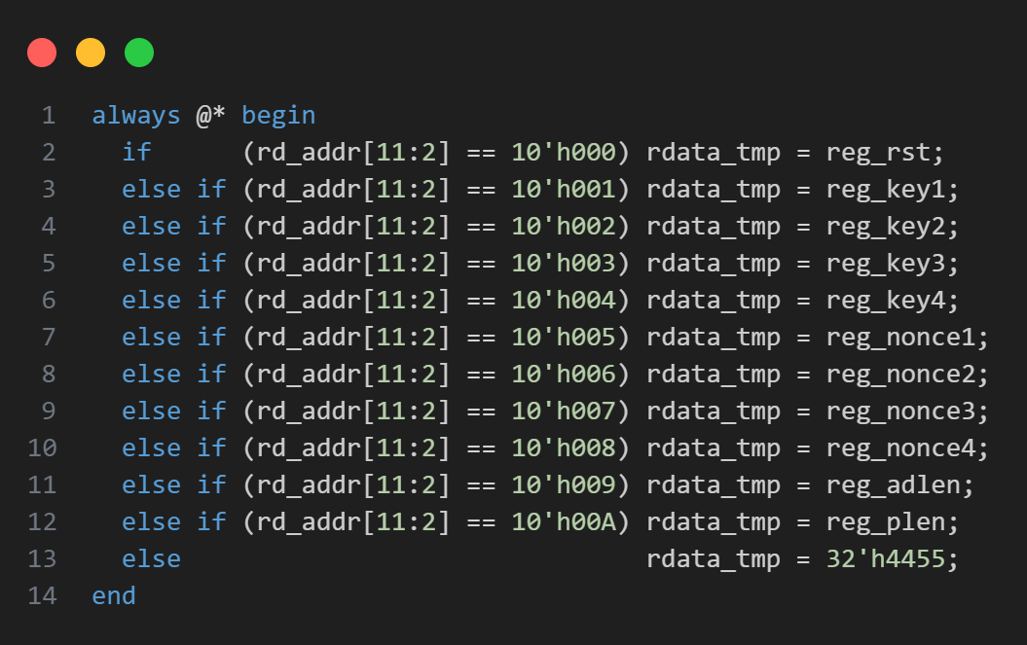

User project R/W test
How to solve the problem of not being able to read ?
Changing the rdata_temp in the user_prj default to any number except zero.

Slide 12
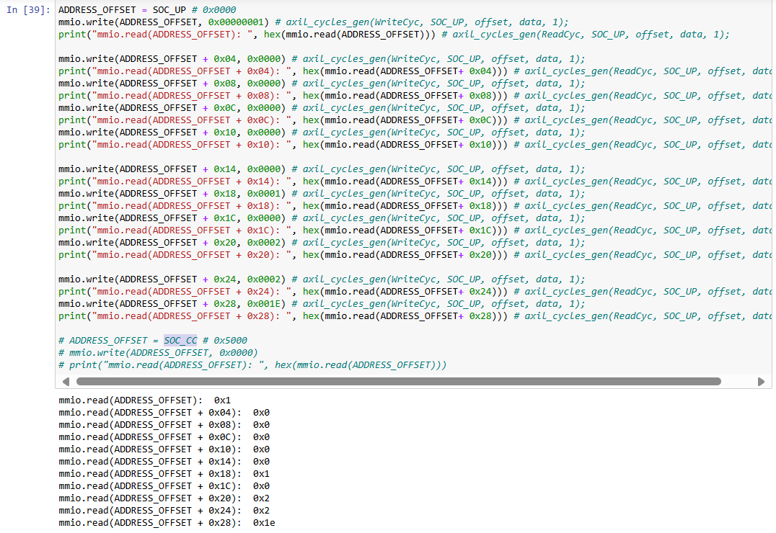

User project R/W test

Slide 13
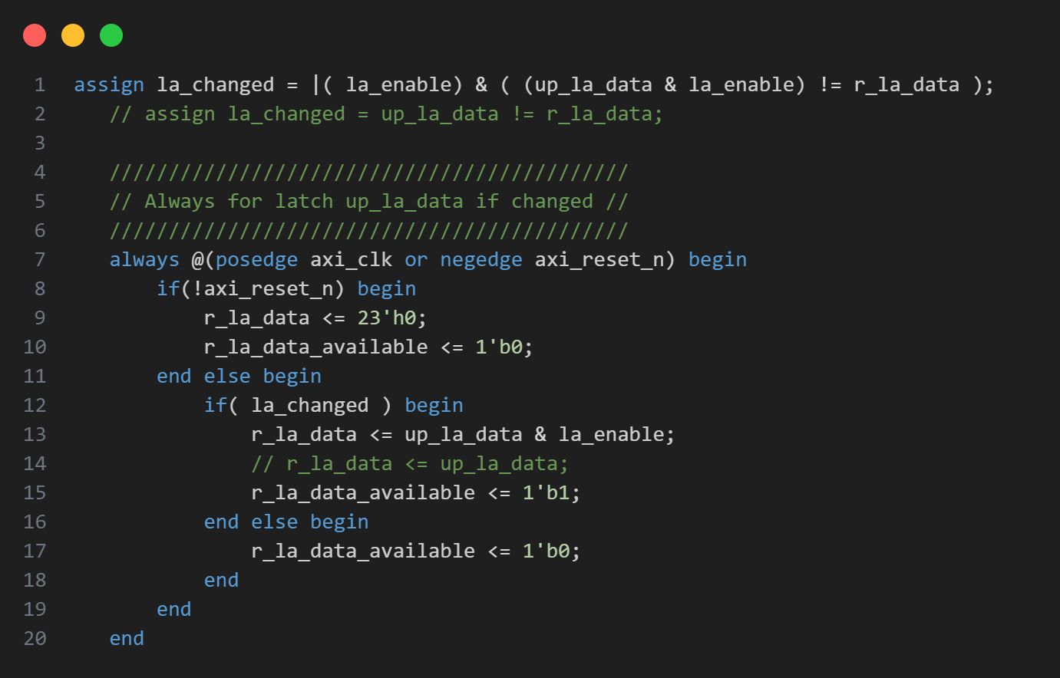
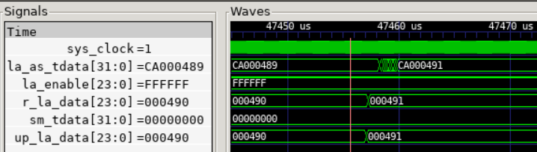
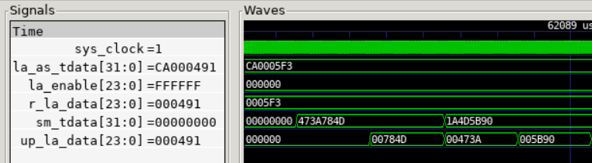
Logic Analyzier

Slide 14
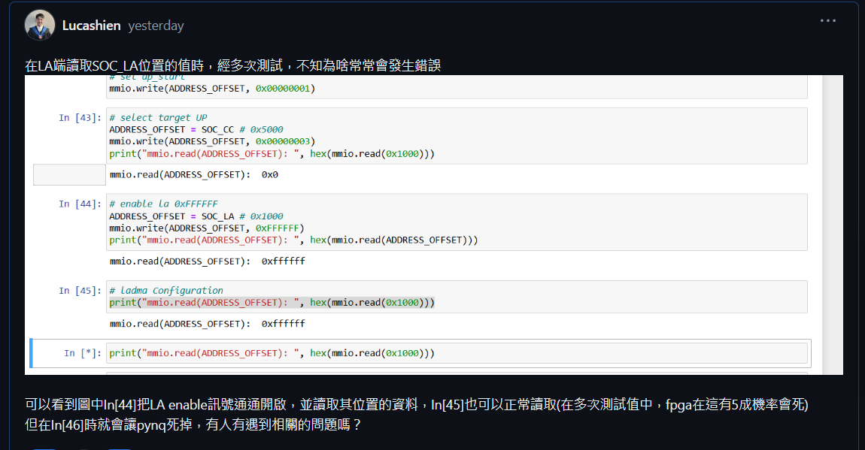
Logic Analyzier Problem
LA enable problem
We cannot success to config the la enable

Slide 15

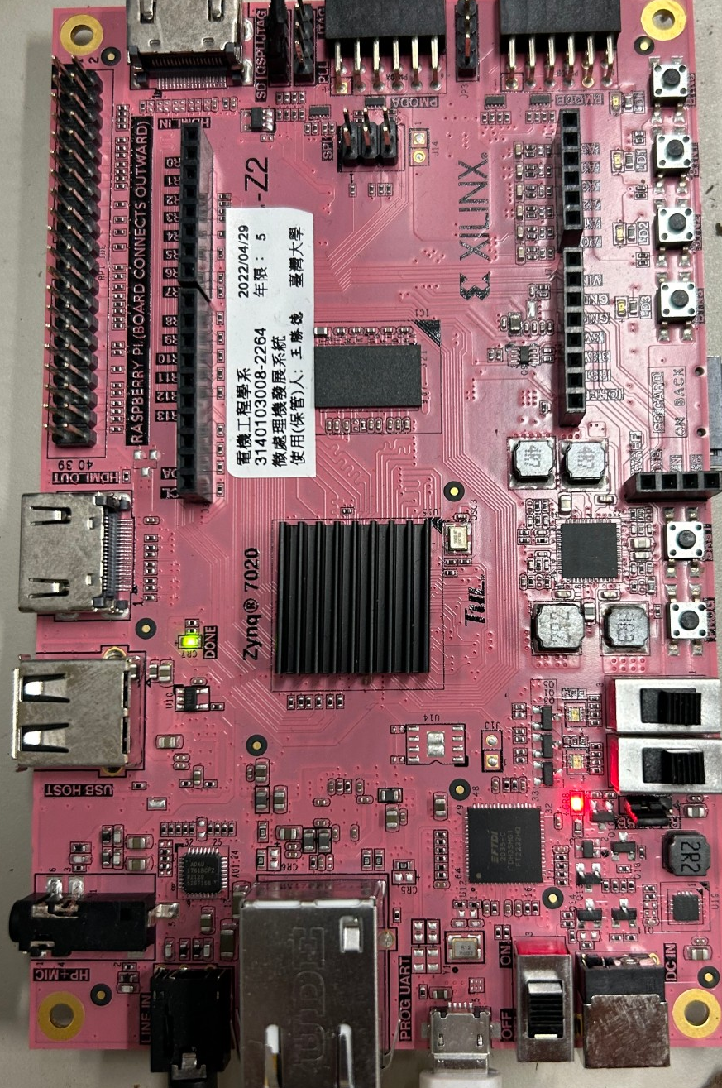
Logic Analyzier Problem
LA enable problem
We cannot success to config the la enable

Slide 16
Comparison
128bits
32bits

Slide 17
Thanks for attention !

